Slide 1
Magnetic Effects of electric current
Chapter 13

Slide 2

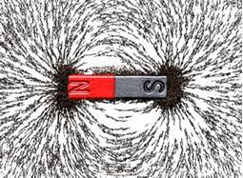
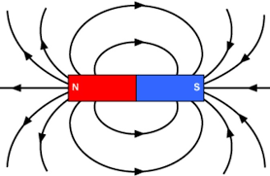
Magnetic field and field lines

Slide 3
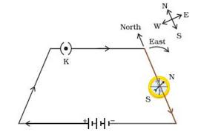
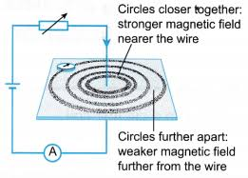
MAGNETIC FIELD DUE TO A CURRENT –CARRYING CONDUCTOR
Magnetic Field due to a Current through a Straight

Slide 4
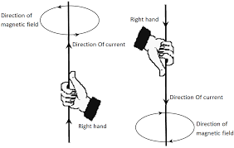
Right Hand thumb Rule

Slide 5
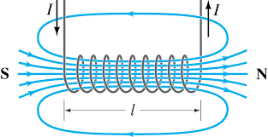
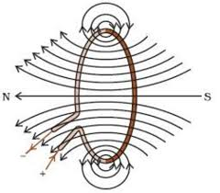
Magnetic Field due to a Current through a Circular Loop
Magnetic Field due to a Current in a Solenoid

